Slide 1
Algorithms
Complexity Beyond Time
Notes:
This slide deck is designed to accompany Chapter 2 of Algorithm Design by Kleinberg and Tardos. Assuming class discussion and brainstorming, it should take about 30-40 minutes.

Slide 2
Other notions of complexity
Space complexity
Measured the same way (using big-Oh notation)
In cases where increasing the space complexity allows the time complexity to drastically decrease, space complexity should be explicitly stated!
Example:
How could you decrease the time it takes for Google to return search results to you (by using extra space)?
Compute the results in advance and store them!

Slide 3
Practical considerations for speed
How could you decrease the time it takes for Google to return search results to you?
Compute the results in advance and store them!
Which results?
The most popular results, not all results.
The internet is global and so is Google.
Which results should you return?
Depends on language and country!
Where should the results be stored?
Putting them closer to the users makes queries faster!
Wait, it does?

Slide 4
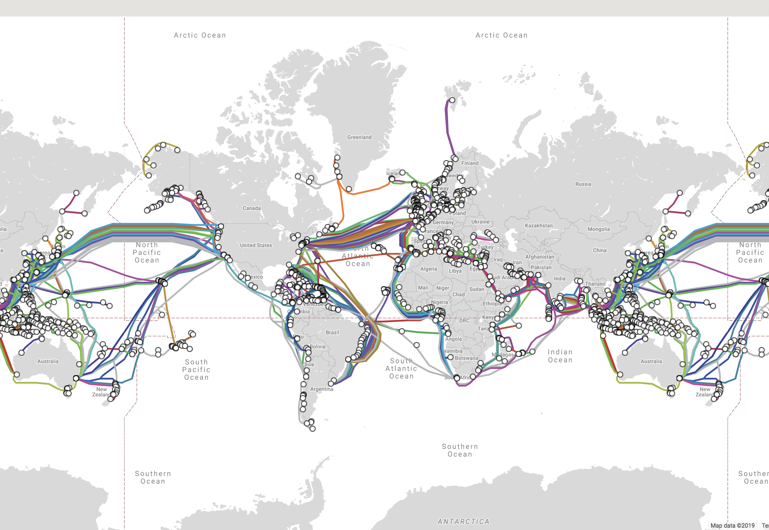
“The internet is a series of tubes”
For fun / quote context see: http://www.cc.com/video-clips/uo1ore/the-daily-show-with-jon-stewart-headlines---internet
https://www.submarinecablemap.com/

Slide 5
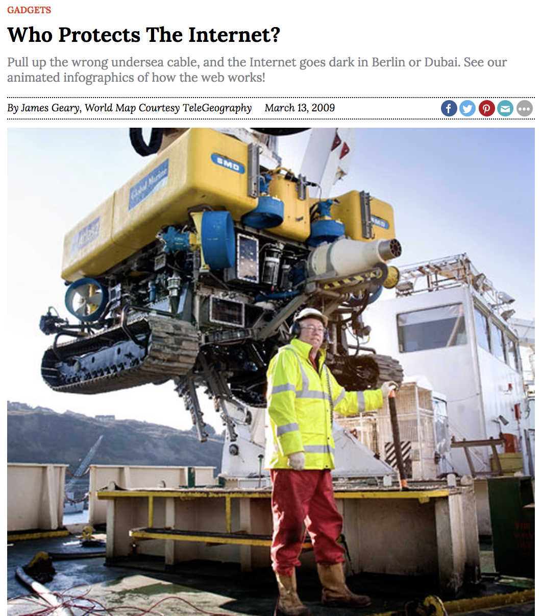
The internet is a series of tubes
The internet is a physical construction that spans the world!
Sending an email from the U.S. to China takes longer than sending it to Canada because it’s further away!
The internet can break underwater and needs to be physically fixed
https://www.soyacincau.com/2017/09/04/several-undersea-cables-are-damage-and-you-might-experience-minimal-slowdown/
https://www.popsci.com/scitech/article/2009-03/who-protects-intrnet/

Slide 6

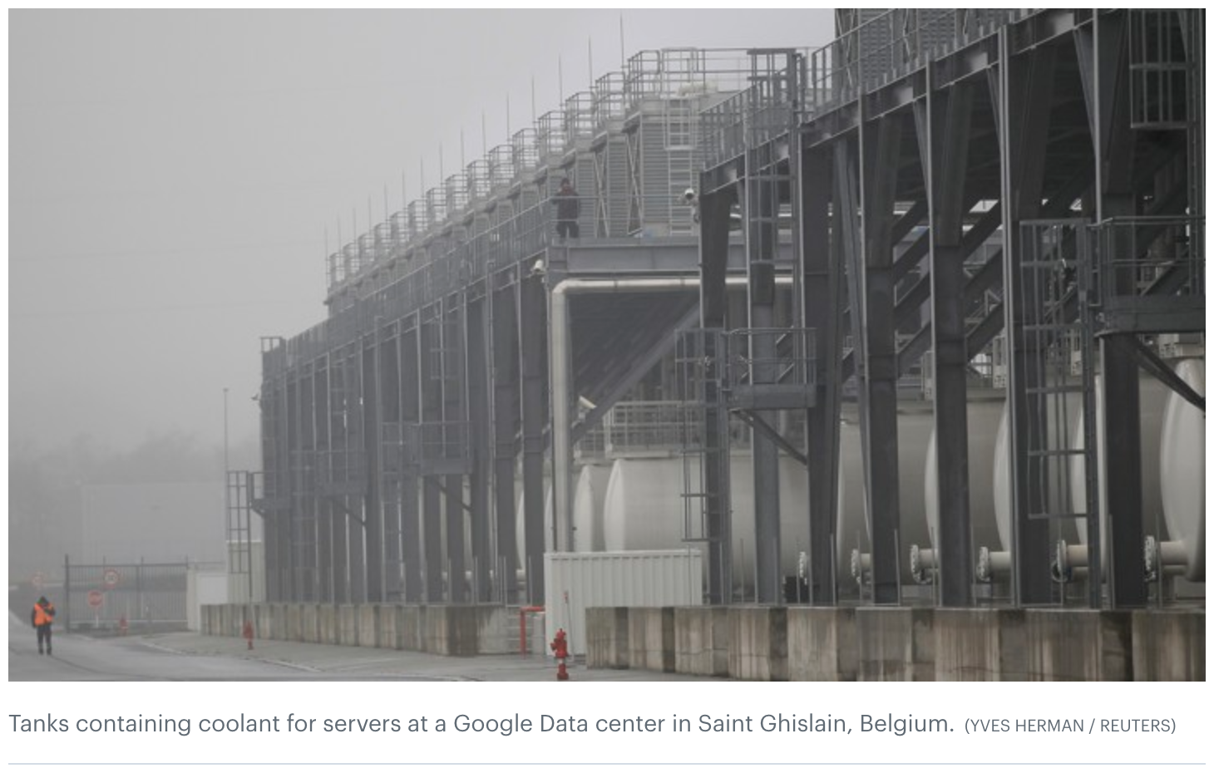
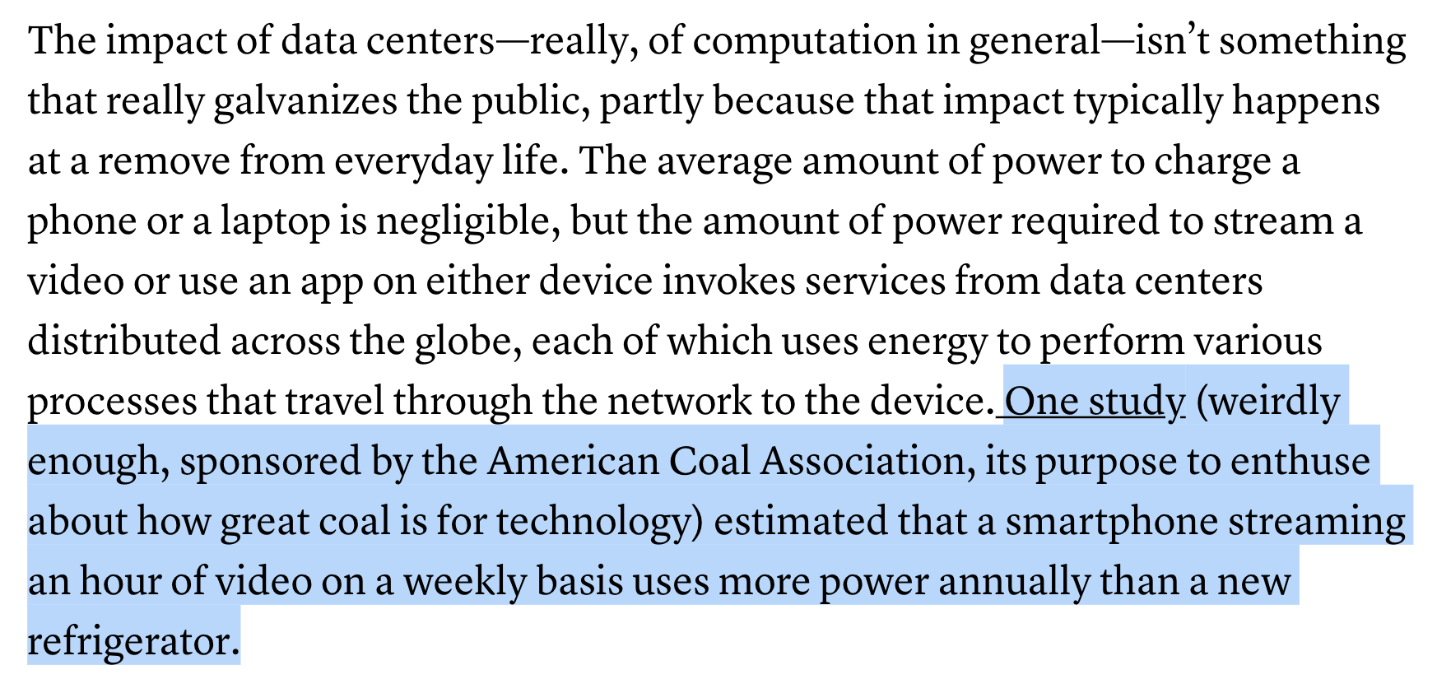
The “cloud” is also a physical construction
https://www.theatlantic.com/technology/archive/2015/12/there-are-no-clean-clouds/420744/

Slide 7
Quantifying environmental impact focusing on individual computer usage
Energy “Complexity”
What’s energy? The amount of work done.
1 joule = the heat radiated from a current of 1 ampere flowing through an electrical resistor with a 1 ohm resistance.
What’s power? Energy per unit time.
1 watt = 1 joule per second.
1 kilowatt = 1000 watts
What’s energy consumed? Power ✕ time interval
1 kilowatt hour = the energy consumed at a rate of 1 kilowatt for 1 hour, or 3,600,000 joules
With thanks to Jon Wilson in Environmental Studies at Haverford!

Slide 8
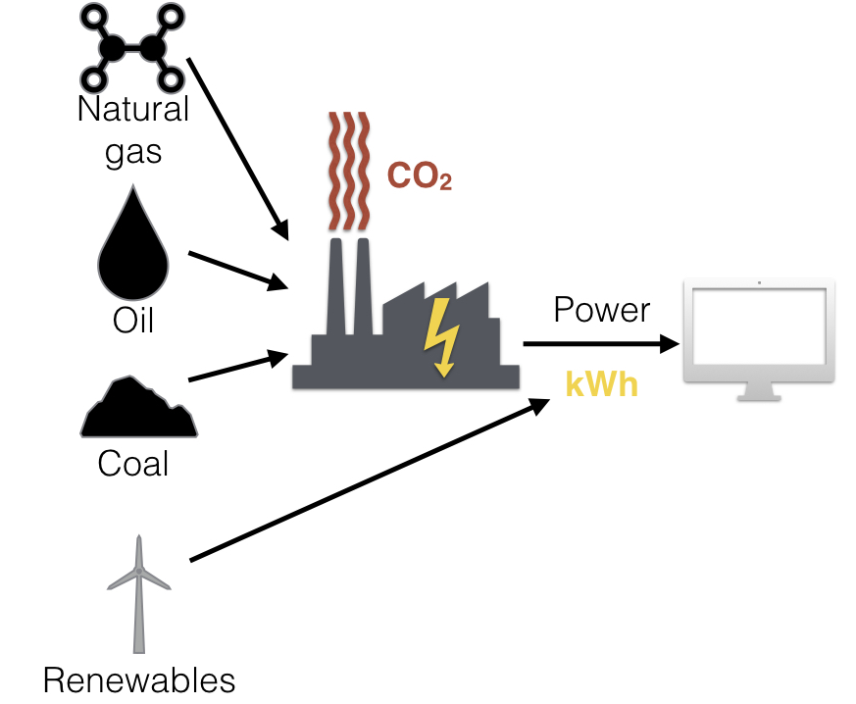
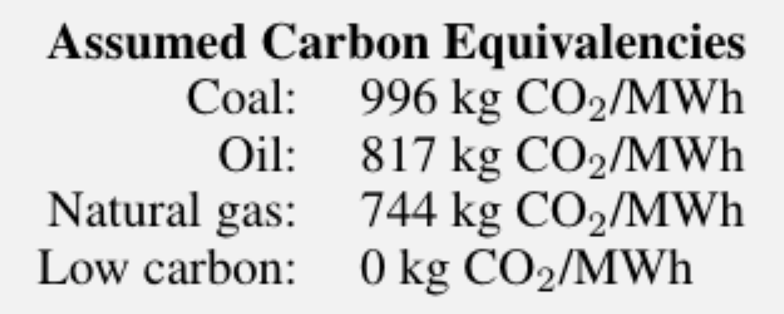
Energy “Complexity”
Quantifying environmental impact focusing on individual computer usage
What does this have to do with environmental impact?
CO₂ emissions depend on kilowatt hours used and on the local energy grid mix.
With thanks to Jon Wilson in Environmental Studies at Haverford!

Slide 9
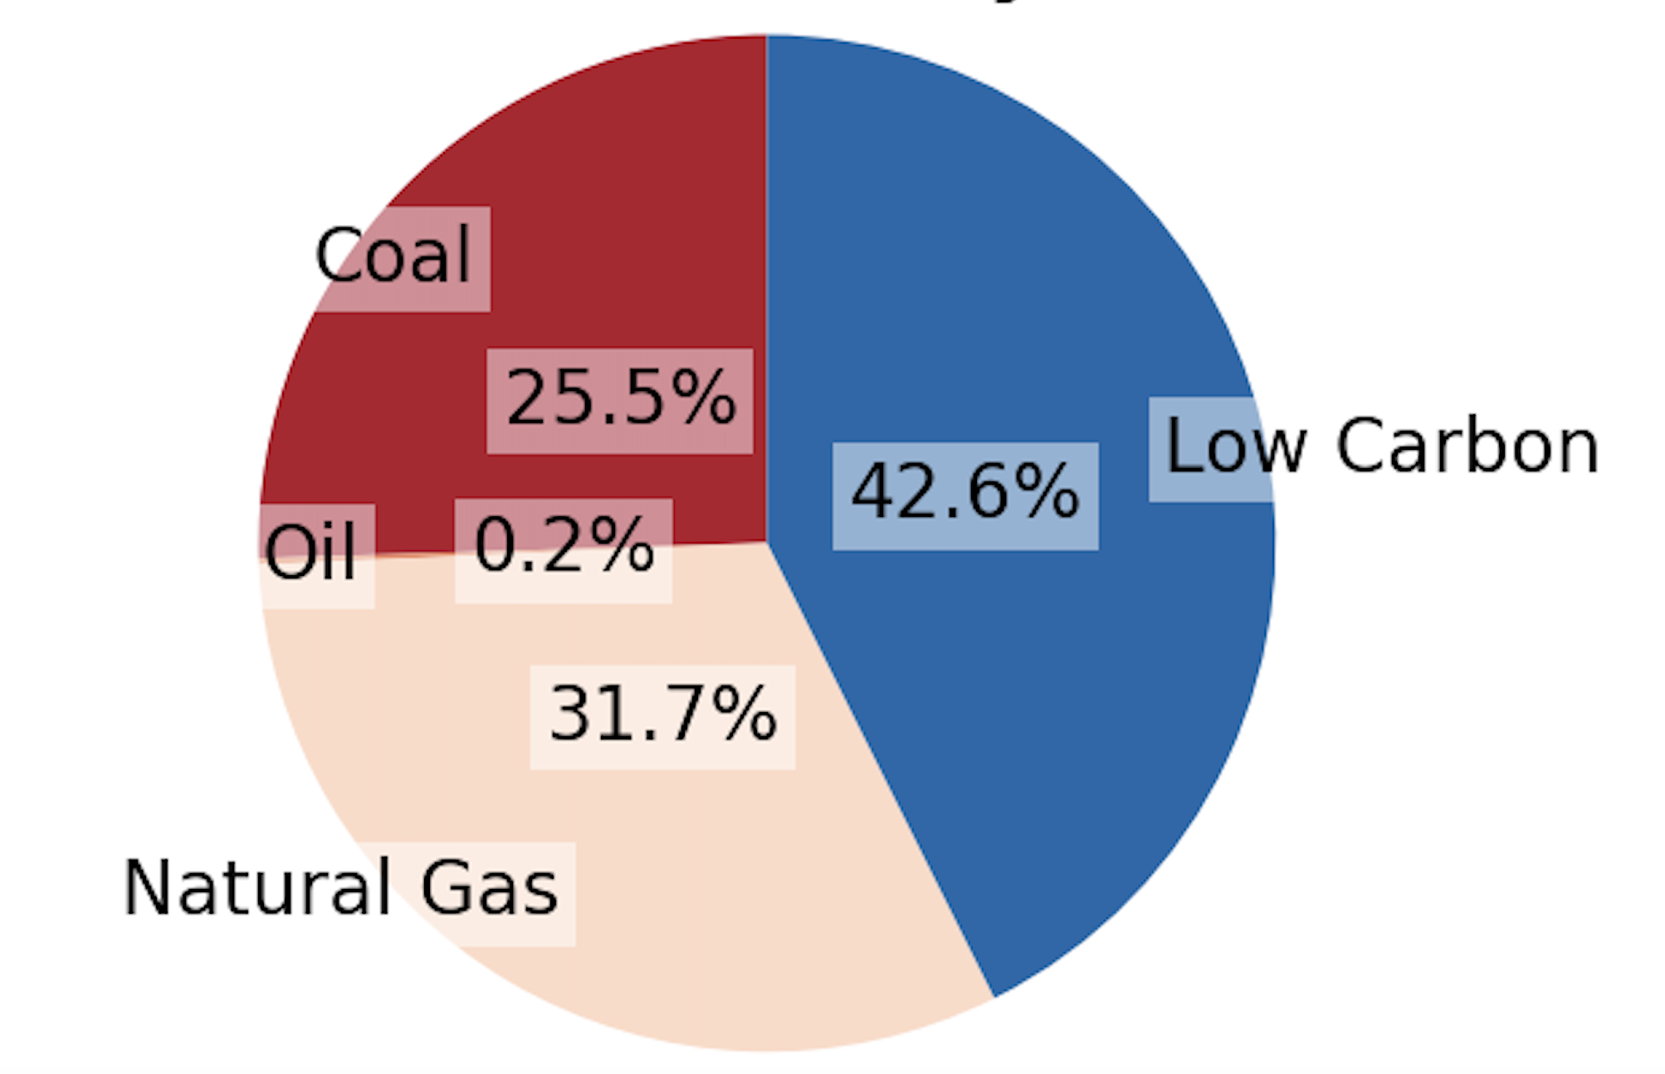
Quantifying environmental impact focusing on individual computer usage
Energy “Complexity”
What does this have to do with environmental impact?
CO₂ emissions depend on kilowatt hours used and on the local energy grid mix.
PA energy mix and assumed emissions rates:
With thanks to Jon Wilson in Environmental Studies at Haverford!

Slide 10
Quantifying environmental impact focusing on individual computer usage
Energy “Complexity”
Summary: how to find the CO₂ emissions of your algorithm
Determine the energy consumption of the algorithm (kilowatt hours) by determining:
power used
time taken
Determine the location and use that to find the energy grid mix
Use the energy grid mix and CO₂ emissions formulas to determine the CO₂ emissions for your algorithm
With thanks to Jon Wilson in Environmental Studies at Haverford!

Slide 11
Quantifying environmental impact focusing on individual computer usage
Energy “Complexity”
Can we analyze the CO₂ emissions based on the algorithm alone?
Good news: in many cases it correlates with the usual notion of computational complexity! Useful when comparing two algorithms in terms of energy usage.
Caveats: these factors may also matter
specific input size (n) used for the run
constant c within the complexity
local grid mix
computer speed
baseline power draw for your computer – could be impacted by temperature, architecture, and other considerations
computer power loss
(You’ll investigate this more in your homework.)
With thanks to Jon Wilson in Environmental Studies at Haverford!

